Slide 1
Behavioral Strategies for Smoking Cessation: Practical Tools for Primary Care Clinicians Updated 2020 Interactive Monograph
© 2020 by the Nurse Practitioner Healthcare Foundation

Slide 2
Faculty
Sean M. Hayes, PsyD Clinical Psychologist Healthcare Behavioral Change Strategist Montreal, Canada Dr. Hayes discloses no conflicts of interest. Jennifer Marjama, PA-C Certified Physician Assistant Physical Medicine and Rehabilitation Southeastern Integrated Medical Chiefland, FL Ms. Marjama discloses no conflicts of interest.
Marjorie Wells, PhD, FNP Project Director and Lecturer Smoking Cessation Intervention UCLA School of Nursing Los Angeles, CA Dr. Wells discloses no conflicts of interest.
Contributing author (E-cigarettes):
Marjorie Crabtree DNP, ANP, FNP - Lead Nurse Planner, Nurse Practitioner Healthcare Foundation
Ms. Crabtree discloses no conflicts of interest

Slide 3
Educational Objectives
As a result of participating in the activity, learners should be better able to:
Describe specific skills to effectively motivate and engage persistent smokers in a collaborative smoking cessation treatment plan
Assess patients’ readiness to quit and stage of change utilizing evidence-based tools
Select the appropriate pharmacotherapeutic and nicotine replacement options for smoking cessation
Develop a smoking cessation treatment plan for patients who desire to quit smoking
Demonstrate screening, risk assessment, and behavioral strategies to enlist patients’ commitment to quit smoking.
Integrate e-cigarette use into their behavioral strategies for smoking cessation.

Slide 4
One of the largest public health threats the world has ever seen, tobacco use is responsible for the deaths of an estimated 7 million people worldwide annually.¹ Here in the United States, data suggest that around 1 in every 5 deaths annually is caused by tobacco smoking, and the rate of death among smokers is roughly 3 times that of people who have never smoked.²
In 2005, the World Health Organization’s Framework Convention on Tobacco Control (WHO FCTC) laid out comprehensive policies for the worldwide control of tobacco use, one of which is the provision of smoking cessation programs in each FCTC member country. Despite the demonstrated effectiveness of smoking cessation programs,³ almost 10 years after ratification of the FCTC only 24 of the 195 FCTC member states have complete policies offering cessation programs, covering only an estimated 15% of the world population.⁴

Slide 5
Here in the US, substantial progress has been made toward all the WHO’s recommended tobacco control policies,⁴ but states still only spend on average 2% of the funds they receive from tobacco taxes and legal settlements on cessation and control programs. This is substantially less than the level recommended by the Centers for Disease Control (CDC), which varies for each state based on its income from tobacco tax revenue and legal settlements.^{5,6} In 2014, a report from the Surgeon General indicated that almost 7 out of every 10 adult smokers want to quit,⁷ suggesting that current demand for smoking cessation support may outweigh the supply of state-funded tobacco cessation programs. An important opportunity therefore exists for care teams, including those providing primary care to patients, to make up that shortfall in providing assistance and support to their patients who express a desire to quit smoking.
This CE activity will provide insights on some of the challenges involved in motivating patients, relevant and realistic guidance to primary care providers (PCPs) who discuss smoking cessation with all their patients, and practical techniques to motivate patients along the path to quitting. Additionally, it will delineate the role that pharmacologic agents can play in this process. The activity also features expert insights on scenarios involving common patient challenges, and links to resources for learners looking for additional help. Finally, the program will aim to convince PCPs that they can be effective agents of change to support quitting behaviors with their patients, and that complete smoking cessation maintenance is achieved only over time, often needing multiple attempts.

Slide 6
Impact of Nicotine Use: Toxicity, Dependence, and Adverse Health
The nicotine contained within tobacco has been regarded as both toxic and addicting since the Surgeon General’s 1988 report on the health consequences of smoking.⁸ Toxicity caused by nicotine is dependent on several factors, including route of exposure, dose, dose duration and frequency, and nicotine formulation. Nicotine in inhaled tobacco smoke is rapidly absorbed into the bloodstream due to the large surface area of the alveoli and small airways and the solubility of nicotine in the lungs’ epithelial layer fluid coating, which has a physiological pH that facilitates absorption. Nicotine from oral tobacco products is absorbed more gradually across the oral mucosa, but more rapidly in the small intestine. Nicotine accumulates in the liver, kidneys, spleen, lungs, and brain as well as in gastric juice and saliva, breast milk, skeletal muscle, fetal serum, and amniotic fluid; estimates suggest that the time it takes nicotine from a cigarette puff to reach the brain is around 10 to 20 seconds.⁷ Patients with acute nicotine toxicity are not often seen in primary care practice; the development of tolerance with repeated exposure is relatively rapid.^{9,10}
Of greater concern to the care team is nicotine’s addictive potential. Nicotine dependence (tobacco use disorder)¹¹ is characterized both by persistence of a drug-taking behavior and emergence of withdrawal symptoms upon abrupt cessation of nicotine administration. Nicotine binds directly to nicotinic acetylcholine receptors in the brain; these are ligand-gated ion channels whose activation results in widespread release of multiple neurotransmitters throughout the brain.¹² Chief among these is the neurotransmitter dopamine. The ventral tegmental area (VTA) of the brain, a focal initiation point of the mesolimbic (reward) pathway, consists of dopaminergic neurons. These cells respond when stimuli indicative of a reward are present, such as opioids or nicotine. The VTA supports learning and sensitization development and these neurons project and release dopamine into both the prefrontal cortex and the nucleus accumbens (Figure 1).¹³

Slide 7
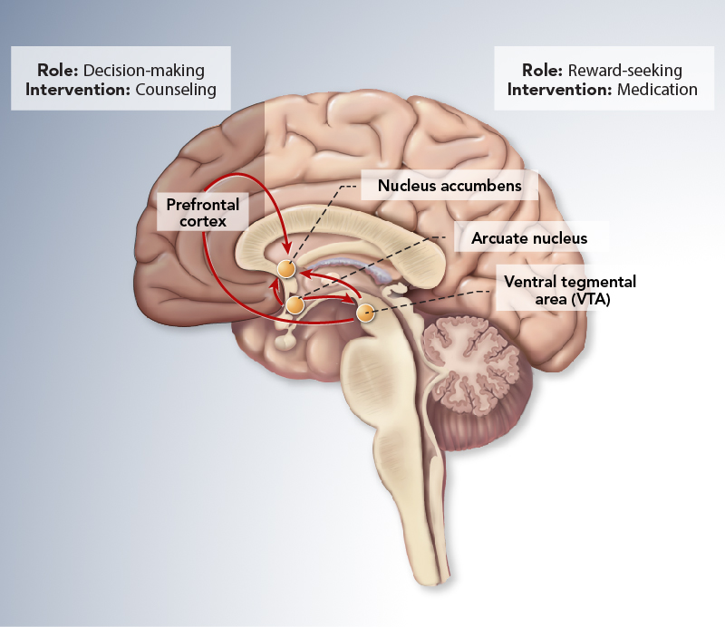
Figure 1: The Mesolimbic Reward Pathway
The prefrontal cortex in the forebrain is important for the integration of all information that contributes to whether any relevant behavior will be elicited. It appears to be the area in which motivation originates and the relevance (salience) of stimuli is determined.¹⁴ The final critical areas involved in the reward pathway are the nucleus accumbens and arcuate nucleus. These regions consist mainly of endorphin- and gamma-aminobutyric acid-secreting (GABAergic) neurons associated with acquiring and eliciting conditioned behaviors and involved in the increased sensitivity (tolerance) to nicotine as addiction progresses.¹⁵
Nicotine dependence develops as a neurobiologic adaptation to long-term nicotine exposure. The trajectory of dependence varies among individuals, but the transition from experimental use to regular smoking can occur with as few as 100 cigarettes.⁷ It is worth noting, however, that all forms of nicotine delivery do not present equal risk in establishing or maintaining dependence. In particular, nicotine replacement therapies (NRTs) are designed to minimize dependence risk. These products carry a low risk of establishing and maintaining dependence and are generally easier to discontinue than tobacco products.¹⁶

Slide 8
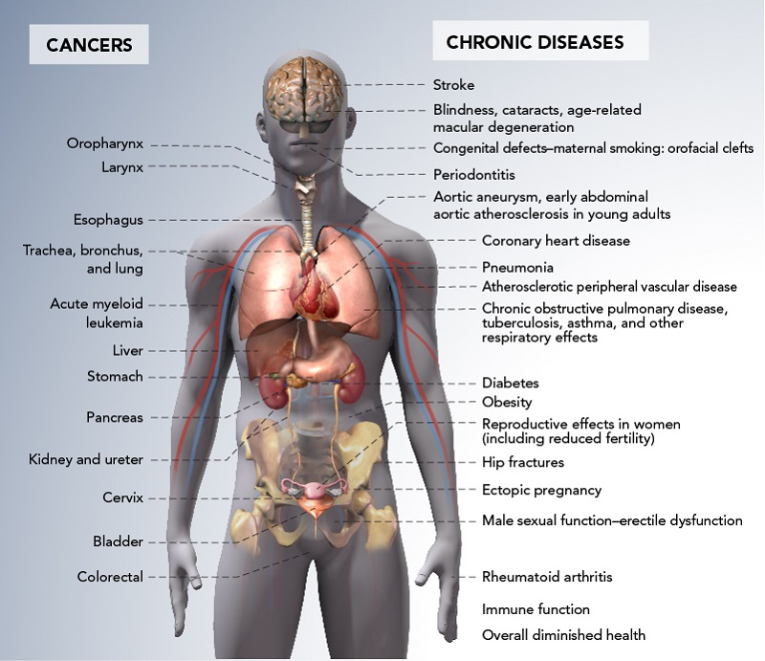
Figure 2: Health Consequences Causally Linked to Smoking⁷
The adverse health consequences of smoking are well-established and too extensive to describe in detail here (Figure 2). However, among the causes of mortality in smokers, the leading 3 are lung cancer, ischemic heart disease, and chronic obstructive pulmonary disease (COPD).¹⁷ The critical issue for primary care is that all these diseases are chronic and long-term, causing a substantial economic and care burden on the care team and health system, and causing the patient substantial distress and significant quality-of-life consequences. Additionally, the secondary smoke consequences for nonsmoking family members are considerable.

Slide 9
One significant example is the link between smoking and type 2 diabetes (T2DM). The causal relationship between smoking and T2DM is well-established; smokers have significantly higher HbA1c than nonsmokers¹⁸ and have almost a 40% greater risk of T2DM than nonsmokers.¹⁹
The American Diabetes Association and the European Association for the Study of Diabetes recommend smoking cessation as an integral component of the management of diabetes.²⁰ Insulin resistance is increased in smokers, likely via increased inflammation and oxidative stress.²¹⁻²³
Given the additional evidence linking smoking with both obesity²⁴ and cardiovascular disease, the impact of which appears exacerbated in smokers with T2DM,²⁵ smoking represents an important modifiable risk factor for T2DM and cardiovascular health that can be addressed in primary care.
Treatment of T2DM occurs in the majority of patients at the primary care level; however, direct treatment of T2DM in a smoker is akin to mopping the floor when the faucet is running; modifying smoking behaviors will help turn off the faucet.

Slide 10
Expert Clinical Insights
Specific populations, such as racial or ethnic minorities, often may be under additional stressors—such as cultural factors, socioeconomic constraints, or family dysfunction—that affect their ability to manage their health. These stressors may be unique to their particular communities and present specific challenges for their primary care providers to manage. Can you provide any insights about data you are aware of or techniques you have found to be successful with any racial or ethnic minority populations?
Current Cigarette Smoking Among U.S. Adults Aged 18 Years and Older By Race/Ethnicity²⁹
Listen to Marjorie
Listen to Jenn
Race/Ethnicity | Prevalence
American Indian/Alaska Natives (non-Hispanic) | 21.9%
Asians (non-Hispanic) | 7.0%
Blacks (non-Hispanic) | 16.7%
Hispanics | 10.1%
Multiple Races (non-Hispanic) | 20.2%
Whites (non-Hispanic) | 16.6%
The URL referenced in Jenn’s audio is: https://www.cdc.gov/tobacco/campaign/tips/resources/data/cigarette-smoking-in-united-states.html

Slide 11
KEY POINT:
Intervention strategies designed for vulnerable populations are of substantial public health importance. In some communities, group events are preferred to individual activities to promote social support and a family-like atmosphere. Education programs that reach the public with information about tobacco use can help individuals make informed decisions about quitting or not initiating tobacco use. Ideally, a tobacco use prevention education program should be directed to a defined population and be sensitive to the social, economic, and cultural issues affecting that population.²⁶

Slide 12
Promoting Motivation for Change in Nicotine Use – Clinicians and Patients
Nicotine (tobacco) dependence is a chronic disease that often requires multiple quit attempts (on average 7 to 9 quitting efforts) before sustained smoking cessation is achieved;²⁷ around half of smokers reportedly make at least 1 attempt to quit each year.⁶ Thus, repeated interventions by clinicians and patients to both attain and maintain abstinence are crucial. However, attaining and maintaining abstinence are incredibly challenging; only around 7% succeed for any length of time (data based on patient’s last cigarette more than 6 months ago), and less than 1 in 3 patients use pharmacotherapeutics or counseling when they attempt to quit.²⁸ Given these statistics, it is easy to understand why both care team members and patients are clinically disengaged or reluctant to discuss the subject during every office visit.
On a more positive note, in 2015 almost 60% of people in the US who had ever smoked had quit, and in the decade 2005–2015, the percentage of people who smoke had dropped significantly across all ethnic groups.^{28,29} Primary care clinicians should understand that abstinence from nicotine is feasible, and a combination of pharmacologic treatment and counseling support is widely accepted as being most beneficial to help patients.³⁰⁻³²

Slide 13
Primary care providers must be able to critically assess each patient’s cognitive, emotional, and behavioral readiness to initiate quitting smoking, and tailor their discussions and intervention plan with each patient accordingly. People only change voluntarily and follow a distinct cognitive-behavioral sequencing33,34:
They become aware that they need to change
They become interested in or concerned about the need for change
They become convinced that change is in their best interests or will benefit them more than cost them
They organize a plan of action that they are committed to implementing
They take the actions that are necessary to make and sustain the change
By correctly assessing the stage of readiness to change, PCPs will be able to see their nicotine-dependent patients not as unmotivated or nonadherent, but as patients who have either a) not shifted in their cognitive-emotional awareness and insight to the need to change, or b) are not ready or do not know how to engage in behaviors that others perceive as helpful.
Many patients have tried to quit, but given their history believe that they cannot succeed and have rationalized their continuance of smoking.

Slide 14
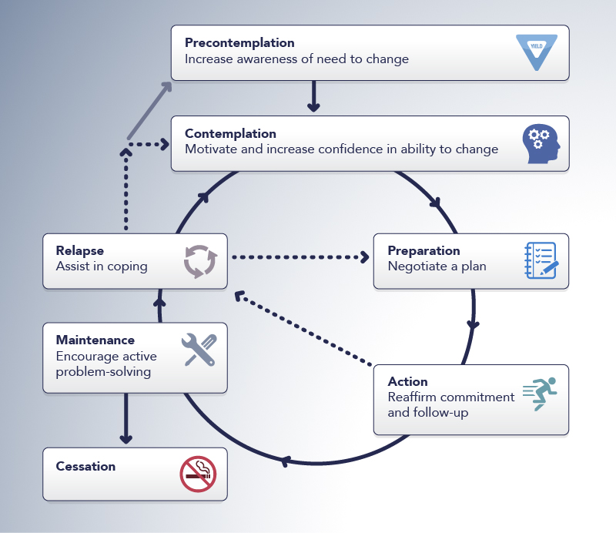
Figure 3: Adult Readiness to Change Behavior: Stages of Change³³⁻³⁵
The evidence-based stages of behavioral change through which individuals progress is a good framework for clinicians to utilize in practice (Figure 3).
A key initial step in this process is to ensure that patients are being asked about tobacco use at every office visit, practice-wide, to build awareness of the dangers and ultimately enhance cognitive dissonance. Cognitive dissonance refers to a situation involving conflicting attitudes, beliefs, or behaviors that, in turn, create feelings of discomfort and imbalance.³⁶ By consistently and nonjudgmentally building awareness of the risks with a patient who persists in smoking, the patient’s smoking behaviors become increasingly dissonant with the understanding that smoking is dangerous for his or her health, and ultimately the patient will be motivated to reduce this state.

Slide 15
However, data from a 2005–2008 survey of outpatient office visits indicated that fewer than two-thirds of patients were screened for tobacco use.³⁷ Consistently and systematically asking about any form or any amount of tobacco use should be part of every visit, as ”social smokers” who only smoke on rare occasions may feel it is acceptable not to identify themselves as smokers. Similarly, users of e-cigarettes, hookahs, or smokeless tobacco products may not realize the combined impact on their dependence; 40% of tobacco users use more than 1 product, incorrectly perceiving non-cigarette products as less risky than cigarettes.³⁸
Three suggested questions are useful in assessing whether a cigarette smoker has clinically meaningful dependence. This is a practical application of the Fagerstrom Test for Nicotine Dependence (FTND)39,40:
How many cigarettes per day do you smoke?
When do you smoke your first cigarette of the day?
What is the longest period of time between cigarettes before you crave another?
An approximate guide is that if the first cigarette is smoked within 30 minutes of awakening and the patient smokes more than 10 cigarettes per day, he or she is likely to be tobacco-dependent. A contributing factor is the age at which the patient first started smoking; the younger the patient started, the more likely he or she is to be tobacco-dependent as an adult.³⁹ Clinicians should use their own judgment when including other tobacco products in this assessment; cigarettes are specifically designed for maximal effectiveness of nicotine intake, and other products are considered to contribute less to tobacco dependence overall when assessed head to head.⁴¹

Slide 16
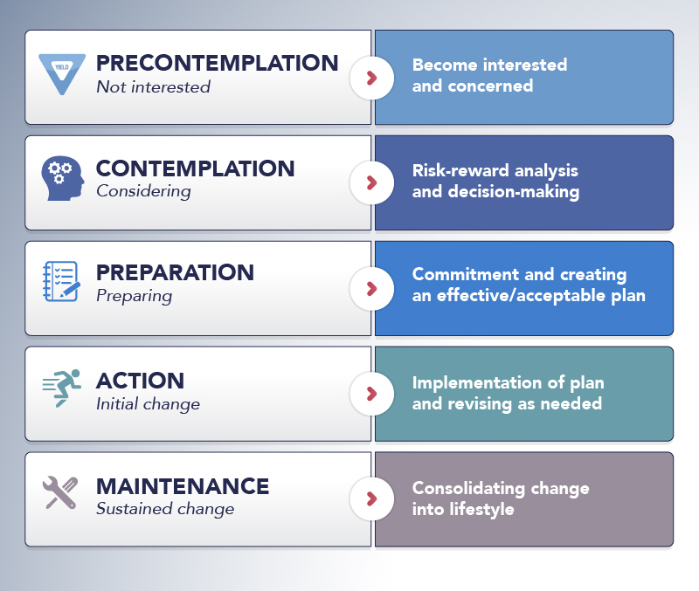
Figure 4: Patient Tasks at Each of the Stages of Change⁴²
Once nicotine dependence is established, it is important for the clinician to assess patients’ readiness (or motivation) to change their behavior.
Identifying the individual patient’s stage of change, particularly precontemplators (those who are not ready to quit) and contemplators (ready to quit), helps direct clinicians in their tasks (Figure 4).

Slide 17
In the Stages of Change model, therapeutic interventions, whether pharmacologic or otherwise, are not offered to precontemplators, as they are not ready to begin the quitting process. In contrast, an alternative approach is to proactively offer treatment, either pharmacologic or psychosocial, in the same way as would be offered for any other chronic disease.
Using that approach, clinicians can continue to:
Reinforce the dangers of not quitting.
Emphasize the positive results of quitting to enhance cognitive dissonance.
Support the potential for success (counter the history of failed attempts) with pharmacologic or psychosocial therapies, and reminders of how effective these are in helping people quit.
Utilize the placebo effect generated by the simple act of initiating an intervention.
Neither approach has been shown to be more effective in randomized trials,⁴³ and it is therefore critical for clinicians to select an approach that they believe in to maximize success with patients.

Slide 18
For tobacco users who are identified as ready to attempt to quit, clinicians should discuss the following plan, which takes the patient from contemplation through preparation and action:
Assess any prior attempts to quit, what the degree of success was, the challenges/ obstacles experienced, and use that knowledge to inform recommendations.
Anticipate any barriers to quitting and proactively set measures to help the patient avoid or overcome them.
Work with the patient to identify negative reinforcement factors in the patient’s daily life and develop a concrete action plan to address these. The presence of a spouse or family member who smokes at home or a colleague at work who invites the patient for “smoke breaks” is a powerful environmental trigger to relapse and can adversely impact the patient’s ability to progress with dose tapering or maintain abstinence after cessation.
Attain concordance with the patient on a quit date and identify whether the patient would benefit from a gradual taper or abrupt cessation on that date. NRT and delivery devices with adjustable doses such as some e-cigarette brands may assist with this process.
Discuss with the patient the use of appropriate pharmacotherapy and counseling approaches.
Facilitate the patient’s access to support and resources.
Arrange a follow-up with the patient after the quit date. This helps boost motivation and allows the clinician to identify any unforeseen barriers, such as withdrawal symptoms or adverse effects of pharmacotherapy.

Slide 19
Figure 5: Clinician Strategies for Patient Motivation as They Move Through the Stages of Change³⁴
For tobacco users who are identified as not yet ready to quit, the task of the clinician at this juncture is to continue to raise doubts in the patient’s mind, thereby building cognitive dissonance—focus on the risks of continuing to use tobacco products (cost, inconvenience, and health consequences) and the benefits of abstinence. Individualizing the message will be very helpful, such as using a personal health risk, risk of secondhand smoking to family members and/or children, or family history if the patient had relatives who smoked and suffered serious health consequences. Motivational interviewing (discussed in the next section) can be an effective tool for precontemplators and is feasible even within the time constraints of a primary care visit (Figure 5).

Slide 20
Patient-identified Barriers to Abstinence
First and foremost, clinicians must be aware that many patients with addictive disorders are reluctant to accept their illness as real.⁴⁴ The adverse effects of smoking are experienced a long way down the road. Patients with addictive disorders, with or without comorbid psychiatric illness, may be particularly prone to minimize the seriousness of their problems and may adhere to intervention regimens erratically as a result. It is important to identify patients who are precontemplators who may not understand, or are actively in denial of, the long-term consequences of smoking, and continue to reinforce the risks they are taking and the benefits of cessation.

Slide 21
A major potential barrier to abstinence that many patients will experience involves symptoms of nicotine withdrawal following reduction in use. The cravings for a cigarette, along with the knowledge that a cigarette can ease the symptoms of withdrawal, often drive the patient to return to tobacco use.
Recent estimates using a longitudinal cohort of smokers suggested that it can take anywhere from 6 to 30 attempts before abstinence is successfully attained.²⁷ Withdrawal symptoms typically peak within the first 3 days of cessation and subside over the next 3 to 4 weeks. Documented symptoms include increased appetite and weight gain, changes in mood (dysphoria or depression), insomnia, irritability, anxiety, difficulty concentrating, and restlessness.¹¹ Withdrawal should be a significant part of any discussion with patients who are getting ready to initiate a quit plan to effectively manage expectations as well as provide a starting point for pharmacologic therapy consideration. All of the first-line pharmacotherapies, as well as NRT, alleviate withdrawal symptoms.

Slide 22
Key Point
Barriers to abstinence include patient fears of common adverse effects such as weight gain and depression after cessation of tobacco use. All patients should be screened for depression in primary care and clinicians should be aware that depression is a major risk factor for substance use initiation in general.⁴⁵ In patients with a history of depression, smoking cessation has been associated with a significantly higher 6-month risk of a new major depressive episode,⁴⁶ so clinicians should be cognizant of their patients’ mental health history when discussing a quit plan.

Slide 23
Key Point
A final key issue among patients is a very rational fear and/or historical experience of failure. The feeling of frustration or of being a “failure” because he or she cannot quit can often influence a patient’s future quit attempts. Patients who relapse often had inadequate psychosocial or counseling support as part of their cessation plan and/or experienced strong withdrawal symptoms, weight gain or mood symptoms.³ Intensification of structured behavioral counseling can be beneficial, particularly as an estimated two-thirds of patient's report wanting to try again within 30 days.⁴⁷ Another discussion around pharmacotherapy is also recommended, particularly if an agent was perceived as helpful in a prior quit attempt. Clinicians should remind patients that most smokers require multiple attempts to attain and maintain successful abstinence. Above all, ongoing motivation is key. Identification of the appropriate clinician strategy pertinent to each patient’s stage of change can be helpful to provide motivation, as change is gradual and may require a structured, step-wise approach for many patients.

Slide 24
Expert Clinical Insights
Smoking cessation can be a physically challenging and extended process for the patient and clinician. When compared with other substance use/addictive disorders—such as alcohol, opioids, or obesity—how challenging is smoking cessation in the primary care setting?
Listen to Marjorie
Listen to Jenn

Slide 25
Practical Aspects and Techniques for Motivating Patients to Change
Motivational interviewing (MI) can be an effective tool for patients who feel they are not yet ready to quit. In MI, clinicians use strategic questioning and empathic listening to help patients resolve their ambivalence about behavior change to initiate quitting and enhance cognitive dissonance regarding the risks of continuing to smoke.
MI works by building motivation and confidence, and the clinician strives to resolve any patient ambivalence about the necessary change.
The overall goal is to help patients understand the discrepancy between where they are and where they want to be and amplify that discrepancy to motivate patients to make the change.⁴⁸

Slide 26
Figure 6: Brief Action Plan for Motivational Interviewing in Primary Care⁴⁹
In primary care, where office visits are time-constrained, the use of a 3-question Brief Action Plan can be helpful (Figure 6). The 3 core questions ask what the patient’s desired goals are, evaluate his or her confidence about making that change, and then request a follow-up to check on the outcomes. Key to MI is the use of questions that allow patients to affirm their goals and state the changes they want to make; effective MI gets the patient to drive change (self-efficacy).

Slide 27
The structured model of 5 Rs can be helpful for clinicians to use with their patients:
Relevance –MI is most effective if the patient identifies personally relevant information.
Risks – The patient should identify his/her personal negative consequences of tobacco use.
Rewards – The patient should be encouraged to identify potential benefits of quitting smoking.
Roadblocks – The patient can be invited to identify barriers to abstinence or negative reinforcements and suggest mechanisms to overcome them.
Repetition – It is critical to repeat the approach at every intervention.
Use of MI has demonstrated a small increase in smoking cessation rates in meta-analyses over care as usual; it is particularly effective when delivered over multiple sessions, each under 20 minutes, making it a feasible approach for primary care clinicians to use.⁵⁰

Slide 28
Central to this approach is the concept of a practice-wide system for querying and documenting tobacco use for each patient at each office visit, regardless of which individual clinician is seeing the patient each time.
This practice-wide approach ensures that:
the patient is approached systematically by all members of the primary care team
a unified message is communicated about the need to quit
the primary care team, not a single team member, is held accountable for successful patient outcomes
The Centers for Medicare and Medicaid Services (CMS) Meaningful Use Core Measures include documentation of smoking status for all patients over the age of 13.⁵¹ Checkboxes in the electronic health record for patients can be used to document smoking status, whether the patient has been referred for counseling, whether pharmacologic therapy has been prescribed, and other data the team wants to document for each office visit.

Slide 29
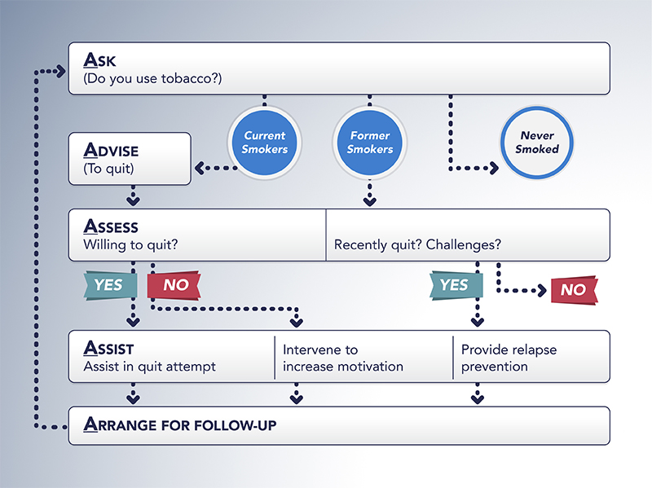
The 5 A's: A Simple Algorithm for Structuring Care Visits
A useful mnemonic for a structured approach to smoking cessation that can be implemented at each clinic visit with the patient by one of the primary care team members, is the 5 As³ (Figure 7):
Ask patients about smoking,
Advise all smokers to quit,
Assess their readiness to quit,
Assist them with their smoking cessation effort, and
Arrange for follow-up visits or contact.

Slide 30
Many of the evidence-based behavioral therapy techniques can be used by PCPs in a primary care setting.
For Example:
Cognitive behavioral therapy (CBT): Cognition influences emotions and behavioral processes. CBT works to help patients change negative behaviors and incorporate healthy lifestyle changes into their tobacco cessation plan.⁵² Interventions include self-monitoring and stress management, relaxation exercises, and coping skills development. CBT is more effective in motivated patients due to the self-observation and self-management at its core. Developing coping skills to manage withdrawal is an area that can be discussed in primary care; examples of coping skills include plans to minimize time spent in the company of smokers, chewing gum or eating small healthy snacks, exercise plans, and distraction techniques such as knitting.⁵³

Slide 31
Evidence-based behavioral therapy techniques
Classical conditioning: Addictive behaviors can become associated with other activities, such as smoking while in a bar or restaurant or watching sports games. Repeated pairing can cause patients to feel a craving for cigarettes simply by being in a bar or restaurant or watching sports. The goal with classical conditioning is to identify and extinguish these cues. If a patient repeatedly bought cigarettes at the gas station while filling up the car with gas on the way to work, for example, he or she could have a family member call at the appropriate time with a reminder not to buy cigarettes or could take the car to the gas station at a different time.
Operant conditioning: Reinforcement and consequences are the basis of much addiction-specific behavioral therapy. When patients use tobacco as a reward or to experience a pleasurable feeling to temporarily mitigate the effects of stress, it becomes more likely that they will use it repetitively. Working through the negative consequences of their actions with patients is the basis of operant conditioning and can help motivate them toward cessation; suggesting alternative rewards or coping skills to mitigate stress can also be beneficial.
These techniques may be used by PCPs to identify and avoid triggers and manage situations where the patient may feel tempted to smoke. Both individual and group therapy techniques are effective.^{3,54} The advantage of group therapy is that it provides a support network that is mutually dependent; positive reinforcement is crucial in successful behavior change and should be a role of the clinician during office visits.

Slide 32
Referrals and Smoking Cessation Resources
Although primary care providers may use individual and group CBT techniques to increase their effectiveness in providing smoking cessation care, successful cessation relies on the patient having access to as many resources and as much information as possible, so he/she is prepared for what to expect and how to overcome challenges. Success may also be enhanced with more in-depth structured psychotherapy, so always consider referral to a psychologist, psychiatric nurse practitioner, or counselor for this level of smoking cessation support. Outside of scheduled counseling and office visits, other counseling approaches should be a part of the information provided to patients:
Telephone counseling: The National Cancer Institute operates a national hotline, 1-800-QUIT-NOW; when patients call this number, they are automatically transferred to their state-run quitline. All 50 states, the District of Columbia, Puerto Rico, and Guam operate quitlines that can be called directly as well as reached using the national number. Telephone-based counseling can be proactive, where counselors call at a prespecified time; alternatively, there is “reactive counseling,” or quitlines, where calls are initiated by the patient, often in response to emergent barriers or other concerns. Proactive counseling approaches have been linked to higher abstinence rates, whereas there is less evidence that reactive approaches improve quit rates or abstinence.⁵⁵ However, one 2005 study in New York that linked reactive counseling to distribution of free NRT was particularly efficacious,⁵⁶ again reinforcing the idea that combinations of support approaches are the most effective.

Slide 33
Referrals and Smoking Cessation Resources
Web-based interventions: Web information and support resources are available from the American Lung Association, American Cancer Society, CDC, www.smokefree.gov, and www.quitnet.com. While many websites attempt to build a level of interactivity and individuality into their resources, the biggest potential challenge to web-based approaches is their general lack of personalization to the individual patient. Every patient is such a unique blend of biopsychosocial traits that applying a one-size-fits-all approach to smoking cessation may not provide sufficient support to attain and maintain abstinence. Perhaps unsurprisingly, the only major study comparing telephone and web-based interventions, performed across 4 US states (Alabama, Arizona, Florida, and Vermont), showed telephone counseling was superior in outcomes to web-based interventions.⁵⁷

Slide 34
Referrals and Smoking Cessation Resources
Phone apps and social network platforms: In 2014, there were 137 free apps for the iPhone available for download in the Apple App Store, and the most recent review of these suggests that few contain any evidence-based behavioral change techniques.58 Ease of engagement and ease of use are major advantages for this type of mobile cessation intervention, but data on their effectiveness are currently lacking. One potential area of app-based interventions are the social media platforms; Twitter and Facebook have shown some promise in small studies promoting motivation and avoiding relapse.^{59,60}
Text messaging: Automated messages conveying motivational reinforcements and positive feedback over text/chat messaging systems have shown effectiveness at promoting 6-month abstinence in several studies.61 A free text program available at www.smokefree.gov allows users to sign up to receive 3 to 5 messages per day for a 6- to 8-week time frame. A list of keywords, such as CRAVE or WANT, can be texted to different numbers to allow users to receive helpful tips or additional motivational support, and for users with smartphones additional support can be requested over the web or by chatting directly with a counselor.

Slide 35
Expert Clinical Insights
Counseling and support options outside of regular clinical visits are critical in assisting patients attempting to quit. What examples or recommendations do you have for these types of options?
Listen to Jenn
Please see the resource section at the end of this activity for a complete list of resources noted by faculty. The www.ahectobacco.com website, referenced by Jenn, refers to the Area Health Education Center (AHEC) of Florida’s smoking cessation program website.

Slide 36
How Pharmacotherapeutics Facilitate the Change Process
All Food and Drug Administration (FDA)-approved agents for aiding in smoking cessation work by alleviating the withdrawal symptoms commonly encountered by smokers after cessation, thereby facilitating the change process by removing a significant barrier. Figure 8 lists some of the considerations for use of the current FDA-approved medications for tobacco and nicotine cessation that are considered to be first-line therapies.⁶³
https://www.aafp.org/dam/AAFP/documents/patient_care/tobacco/pharmacologic-guide.pdf
¹Pregnant smokers should be encouraged to quit without medication based on insufficient evidence of effectiveness and theoretical concerns with safety. Pregnant smokers should be offered counseling interventions that exceed minimal advice to quit.³
²Wholesale acquisition cost obtained from Red Book Online. Thomson Reuters, December 2016
MAO, monoamine oxidase; OTC, over-the-counter, Rx, prescription product.
For complete prescribing information and a comprehensive listing of warnings and precautions, please refer to the manufacturers’ package inserts.

Slide 37
Figure 8: Considerations for Clinical Use of FDA-approved Pharmacotherapy for Smoking Cessation⁶²

Slide 39
Some specific patient considerations and potential barriers to the use of NRT include:
Smokers might worry that they will remain dependent on nicotine if they use NRT. Clinicians should advise patients that this is a very rare occurrence.⁶³
Gums and lozenges are the most commonly used short-acting NRTs and both are available over the counter. Clinicians should advise patients that there are different techniques associated with correct use of these products and, while both product types appear similarly efficacious, patients should avoid changing between products to minimize risk of incorrect use. The lozenge should not be chewed; it dissolves in the mouth. By contrast, the gum should be chewed with correct technique; chewing too fast will release nicotine too quickly and it will be swallowed instead of absorbed across the buccal mucosa. The so-called “chew and park” technique is recommended; patients should chew the gum until the nicotine flavor is detected, then “park” the gum in their cheek to allow absorption. When the taste disappears, the patient should repeat; after around 30 minutes the gum can be discarded.

Slide 40
Some specific patient considerations and potential barriers to the use of NRT include:
It is preferable for clinicians to advise patients not to leave transdermal patches on overnight. Abstinence rates are reportedly the same for 24-hour dosing versus removal of the patch overnight,⁶⁸ and leaving the overusing them.
Patients may erroneously believe that the use of other nicotine delivery methods—such as snuff, hookahs/water pipes, chewing or packet tobacco, or e-cigarettes—may be safer than the patch on overnight which increases the rates of adverse events such as insomnia and hypnagogic hallucinations.⁶³
The 2 prescription products, the nasal spray and oral inhaler, provide some potential additional assistance to patients in that they partially mimic the physical use of a cigarette, more so for the oral inhaler. The nasal spray is probably the fastest system for nicotine delivery into the bloodstream, peaking about 10 minutes following delivery of the aqueous spray.⁶⁹ They are also likely the most burdensome (2 uses of the nasal spray per hour) and public of the delivery devices, and some patients may feel embarrassment in smoking cigarettes, and that these approaches can be used as aids in cessation. Some e-cigarette brands allow dose adjustment and therefore could be used to aid cessation, but this has yet to be established in formal trial settings. Clinicians should definitely discuss tobacco options with their patients, as intake of nicotine and other toxins present in tobacco by any means is still adversely affecting their health.

Slide 41
Varenicline
Varenicline is a nicotinic acetylcholine receptor partial agonist, which is effective in smoking cessation, and works via a similar overall approach to NRT; instead of low-dose nicotine alleviating withdrawal symptoms, varenicline partially stimulates the receptor bound by nicotine for a similar end result.⁷¹ It has also been theorized that, because varenicline binds the receptor with very high affinity, it may prevent nicotine from binding the receptor and thereby reducing some of the reward feelings induced.⁷¹ This allows the clinician to have the patient start varenicline 1 week before quitting cigarettes. This may also be helpful for patients who are ambivalent about quitting but are willing to try reducing their nicotine intake. Clinical trial data indicate that not only may a longer lead-in time of varenicline be beneficial as part of the treatment plan for some patients, allowing them to reduce nicotine intake prior to cessation,⁷² but also that in patients who do not wish to quit immediately, but instead reduce dose and aim for cessation in the following 3 months, varenicline use can improve abstinence rates.⁷³

Slide 42
Bupropion
Sustained-release bupropion is the second non-NRT agent approved by the FDA for smoking cessation. More commonly encountered in primary care practice as an antidepressant, bupropion is a norepinephrine and dopamine reuptake inhibitor. Its mechanism of efficacy in smoking cessation is unclear; the prevailing idea is that because the reward neurotransmitter dopamine persists in synaptic clefts due to reuptake being abrogated, the reward feelings are sustained longer and withdrawal symptoms are blunted. Effectively bupropion may be working downstream of varenicline and NRTs to achieve the same result. One head-to-head study of varenicline and bupropion recently indicated that varenicline is more effective at promoting abstinence,⁷⁴ but clinicians must select therapy based on patient preference and other considerations. For example, bupropion may be a more suitable choice in patients with pre-existing depression, as it may help mood symptoms; bupropion may also be a better selection for patients concerned about weight gain following cessation, as bupropion helps mitigate this.⁷⁵

Slide 43
Expert Clinical Insights
There can be a perception among patients that different nicotine delivery methods are safer and less addicting than cigarettes. What advice do you have for clinicians on how to discuss this with their patients?
Listen to Marjorie
Listen to Jenn

Slide 44
Expert Clinical Insights
Could you describe some examples of individual patient factors that typically influence your choice of pharmacotherapy to assist a patient in quitting?
Listen to Marjorie
Listen to Jenn

Slide 45
Hookah Myths and Truths
Hookah use is increasing in our society, especially among youths and college students.
While many hookah smokers may think this practice is less harmful than smoking cigarettes, hookah smoking has many of the same health risks as cigarette smoking.
Water pipe smoking delivers nicotine—the same highly addictive drug found in other tobacco products.
The tobacco in hookahs is exposed to high heat from burning charcoal, and the smoke is at least as toxic as cigarette smoke.
Because of the way a hookah is used, smokers may absorb more of the other toxic substances found in cigarette smoke than cigarette smokers do.
An hour-long hookah smoking session involves 200 puffs, while smoking an average cigarette involves 20 puffs.
The amount of smoke inhaled during a typical hookah session is about 90,000 milliliters (mL), compared with 500–600 mL inhaled when smoking a cigarette.
Hookah-Myths & Answers https://www.cdc.gov/tobacco/data_statistics/fact_sheets/tobacco_industry/hookahs/index.htm

Slide 46
“No form of smokeless tobacco is a safe substitute for cigarettes. Still, tobacco companies often market these products as alternatives to smoking in places where smoking isn’t allowed.”
Health Risks of Smokeless Tobacco
https://www.cancer.org/cancer/cancer-causes/tobacco-and-cancer/smokeless-tobacco.html

Slide 47
Key Point
A recent article presents a case in which a 19-year-old pregnant patient told the nurse practitioner (NP) that she quit smoking “cold turkey” early in her pregnancy but did not gain adequate weight and had a preterm delivery of a low-birth-weight infant with fetal malnutrition.⁷⁰ When the NP asked again about smoking, she found out that, while the patient did indeed quit smoking cigarettes, she had switched to vaping (using an electronic nicotine delivery system [ENDS]). The NP realized she had not asked about other forms of tobacco use and missed an opportunity to discuss tobacco cessation.

Slide 48
E-Cigarettes
E-cigarettes have the potential for a public health benefit if they help smokers to quit smoking combustible cigarettes, especially for those who are not willing or able to quit using current FDA smoking cessation approved treatments. The potential benefit must be balanced against e-cigarettes long-term health risks, which are still being researched at this time, and against the potential for e-cigarettes to attract young people who might not otherwise smoke to take up their use and even increase their initiation of smoking cigarettes (Barua, Benowitz, Cummings, et al. 2018). E-cigarettes are not safe for youth, young adults, pregnant women, as well as adults who do not currently use tobacco products. (CDC Retrieved 4/13/20).
E-cigarette use is called vaping. E-cigarettes have a battery, a heating element, and a place to hold a liquid and come in different shapes and sizes. They produce an aerosol by heating a liquid that usually contains nicotine which is the addictive drug in regular cigarettes, cigars, and other tobacco products, flavorings, and other chemicals that help to make the aerosol. Users inhale the aerosol into their lungs and by standers breathe the aerosol as the user exhales into the air, causing bystander exposure. E-cigarettes have many different names. They are called “e-cigs,” “vapes,” “vape pens,” “e-hookahs,” “mods,” “tank systems,” and “electronic nicotine delivery systems (ENDS).” E-cigarettes may look like regular cigarettes, cigars, or pipes, and resemble pens and USB sticks.

Slide 49
E-Cigarettes
E-cigarettes are still fairly new, and research is ongoing to determine their long-term health risks including lung injury. Most e-cigarettes contain nicotine, which has known health effects. Nicotine is highly addictive and is toxic to both pregnant women and developing fetuses. (DHHS, 2016)
Nicotine can harm adolescent and young adult brain development, which continues into the early to mid-20s (DHHS, 2016). Youth e-cigarette use is associated with the use of other tobacco products, including cigarettes. E-cigarettes are the most commonly used tobacco product among youth. In 2019, over 5 million U.S. middle and high school students used e-cigarettes in the past month, including 10.% of middle school students and 27.% of high school students. In 2017, 2.8% of U.S. adults were current e-cigarette users. In 2015, among current e-cigarette users aged 18–24 years, 40.0% had never been regular cigarette smokers (CDC Retrieved 4/20/2020).
The e-cigarette aerosol that users breathe from the device and exhale can contain harmful substances, including nicotine, cancer-causing chemicals, flavoring such as diacetyl, a chemical linked to a serious lung disease, heavy metals such as nickel, tin, and lead, and ultrafine particles that can be inhaled deep into the lungs. E-cigarette aerosol generally contains fewer toxic chemicals than the deadly mix of 7,000 chemicals in smoke from regular cigarettes.

Slide 50
E-Cigarettes
Defective e-cigarette batteries have caused fires and explosions, which have resulted in serious injuries. Most explosions happened when the e-cigarette batteries were being charged. Acute nicotine exposure can be toxic. Children and adults have been poisoned by swallowing, breathing, or absorbing e-cigarette liquid through their skin or eyes.
The CDC, the U.S. Food and Drug Administration (FDA), state and local health departments, and other clinical and public health partners are investigating a national outbreak of e-cigarette, or vaping, product use-associated lung injury (EVALI). (CDC April, 2020). Sixty-eight deaths have occurred in the US from EVALI as of Feb 2020.
National and state data from patient reports and product sample testing show tetrahydrocannabinol (THC)-containing e-cigarette, or vaping products, from informal sources such as friends, family, or online dealers, are linked to most EVALI cases and play a major role in the outbreak. Vitamin E acetate is strongly linked to the EVALI outbreak. Vitamin E acetate has been found in product samples tested by FDA and state laboratories and in patient lung fluid samples tested by CDC from geographically diverse states. CDC will continue to update guidance based on ongoing studies related to EVALI as appropriate. (CDC, Retrieved 4/20/2020).

Slide 51
E-Cigarettes
In Dec 2018, President Donald Trump signed a new law which immediately raised the federal minimum age for purchasing tobacco products — including nicotine vaping products from 18 to 21. The Trump administration then announced a new policy in Jan, 2020 that the sale of some, but not all, flavored vapes will be forbidden. According to the FDA, the agency responsible for the policy, the change is an attempt to limit the alarming rise in the use of e-cigarettes by teens, who overwhelmingly prefer flavors, while balancing the potential benefits to adults who already smoke.
FDA’s perspective is that all vapes, as newer tobacco products, need agency authorization to be on the market legally. The policy prohibits the production, distribution and sale of all flavored cartridge-based e-cigarettes, with the exception of menthol and tobacco flavors. A manufacturer must now show that an unauthorized flavored cartridge is “appropriate for the protection of public health” and receive FDA authorization, the product will not be allowed on the market. There are no penalties for vape users. (FDA, Retrieved, 4/20/20)

Slide 52
E-Cigarettes
The CDC and FDA recommend that people not use THC-containing e-cigarette, or vaping products, from informal sources like friends, family, or online dealers. Vitamin E acetate should not be added to any e-cigarette, or vaping products.
Adults should contact their healthcare professional if they need help quitting tobacco products, including e-cigarettes, as well as if they have concerns about EVALI.E-cigarette, or vaping, products should never be used by youths, young adults, or women who are pregnant. Adults who do not currently use tobacco products should not start using e-cigarette, or vaping, products. Persons engaging in ongoing cannabis use that leads to significant impairment or distress should seek evidence-based treatment by a healthcare professional. (CDC, Retrieved 4/20/20).

Slide 53
E-Cigarettes
The provider’s role is to encourage and support a smoker’s efforts to stop using cigarettes and other combustible tobacco products. Providers should advise cigarette smokers who seek to quit to use evidence-based, FDA-approved, safe, and effective smoking cessation pharmacotherapies as first-line treatments in preference to e-cigarettes. Providers should be prepared to discuss the risks and benefits with patients who are already using an e-cigarette or may be interesting in using e-cigarettes. If a smoker decides to use e-cigarettes, the provider should be supportive to help the patient to use the product in a manner that minimizes risk to themselves and others and indicate that the final goal is total abstinence from all products, including e-cigarettes. (Barua, Benowitz, Cummings, et al. 2018)

Slide 54
Behavioral Counseling
According to clinical practice guidelines³:
Behavioral counseling rather than pharmacotherapy is the recommended treatment for:
Smokeless tobacco users
Individuals smoking fewer than 10 cigarettes per day
Adolescents
Pregnant smokers, who should be offered person-to-person psychosocial interventions that exceed minimal advice to quit

Slide 55
Clinicians should create an environment where the patient feels comfortable discussing issues with taking medicines as prescribed.
Central to facilitating the change process in smokers is the perceived helpfulness of the pharmacologic therapy. Perceived helpfulness is a multidimensional variable, covering efficacy and safety, best fit for the individual patient, and burden of treatment, among others.
Adherence to therapy has been a major confounding factor in the success of addiction pharmacotherapies; motivating adherence to a regimen that denies the patient a sense of reward is a significant challenge for the clinician, and one eased if the adherence burden of the product is lower.

Slide 56
Reasons for medication nonadherence include complexity of the regimen, anticipation of side effects and withdrawal, uncertainty regarding the effectiveness of pharmacotherapy, and psychiatric comorbidity that the patient feels may be worsened.⁴⁴ In this regard, longer-acting and sustained-release formulations can be beneficial for both the clinician and patient.
Clinicians should also emphasize how helpful the pharmacotherapy can be. Many clinical trials for pharmacotherapies in psychiatric illness are marked by a prominent placebo effect; that is, the simple act of an intervention is enough for the patient to feel better. When discussing pharmacotherapy with patients, clinicians should keep the placebo effect in mind, and stress how effective the medication can be—eg, “I have had a lot of success with this approach to quitting with patients just like you. I feel confident that this plan has an excellent chance of success.”

Slide 57
Figure 9: Rapid Change in Patient Behavior With Placebo Treatment in Clinical Studies Into Alcohol Dependence⁷⁶
Other clinical trials in addiction pharmacotherapy have demonstrated rapid behavior change even with placebo (Figure 9); clinicians should take note of this potential effect.
Clinicians should also emphasize the use of adherence aids where necessary. NRTs other than the transdermal patch must be taken routinely, and patients may require some help in remembering, so reminder notes, calendars, alarms, pill boxes, and smartphone apps all can be effective in improving adherence, which will help improve the behavior change toward abstinence.
†Median number of drinks per day over previous month. Red highlighted box: at one day following treatment initiation, a significant percentage of patients taking only placebo had reduced their intake of alcohol.
XR-NTX = extended-release naltrexone.

Slide 58
Case Vignettes & Discussion

Slide 59
Case 1: Smoking to Cope
Male, 32 years old, white, veteran. He is married, with 2 young children at home. He was deployed twice to a combat zone and started smoking while deployed. Since his return home, his wife is adamant that he quit smoking for his own health as well as the health of his family. While he is motivated to quit, he is concerned about losing the calming effects of nicotine.
Listen to Marjorie Listen to Jenn

Slide 60
Key Point
Discuss triggers for tobacco use including “stressful” situations, negative affect, presence of other smokers, mealtimes, alcohol/coffee consumption, tobacco cravings, etc. Identify triggers prior to quitting, while the patient is still smoking “normally,” which will provide insight into the person’s tobacco use behavior. A clear understanding of the triggering behaviors will help the patient to change more effectively.
Evaluate routine/situations associated with tobacco use—eg, drinking coffee, at a bar with buddies, during work breaks (especially if around other smokers), driving the car, when bored or stressed, when watching TV, while on the telephone, after meals or sex, or with specific friends or family members who smoke.

Slide 61
Case 2: Learned Helplessness & Smoking
Female, African American, 52 years old, divorced and living alone, as her children have moved out and away. She reports being isolated and lonely, and finds little pleasure in work or her daily activities anymore. She has tried quitting repeatedly, only to relapse quickly, and no longer believes that she can be successful at quitting, or at much else in her life.
Many patients may benefit from the support of other people who are trying to quit or who have quit successfully. Could you describe the role that support networks can play for patients like this who feel isolated?
Listen to Marjorie Listen to Jenn
How would you go about boosting motivation and encouragement in this type of patient? Is she ready to begin another quit attempt or would this patient benefit more from encouragement at this visit and perhaps aiming to reduce cigarette use instead?

Slide 62
Case 3: Smokes to Avoid Weight Gain
Female, Latin American, 31 years old, employed full-time, married with 2 young children at home. She smokes daily but inconsistently and she states that she smokes outside the house, away from her children. She has tried to quit in the past; however, she reports she “immediately gained weight” and then relapsed. She states that she is motivated to quit but even the possibility of weight gain after cessation is a barrier to quitting.
Listen to Jenn Listen to Marjorie
How often does weight gain occur, and how much weight is gained, in patients who quit? Are there any other concerns like this that may scare patients away from making a quit attempt?

Slide 63
Key Point
Many common fears smokers have about quitting include:
1. They will gain too much weight
Emphasize that quitting is the single most important thing the patient can do for her health, that weight gain can be managed, and that you will work with her on a plan. Tobacco-related diseases are the major cause of death in Hispanic populations. Diabetes is the fourth leading cause of death in this population, and tobacco use contributes to the development of diabetes. The patient’s children will benefit from her healthier lifestyle without additional secondhand smoke exposure. Some pointers include⁷⁷:

Slide 64
Not everybody who quits gains weight.
Nicotine suppresses appetite, so quitting often increases a patient’s appetite.
The average weight gain is 6 to 11 pounds.
Weight gain typically happens early in the quit process during the days when the patient is withdrawing from nicotine.
Use of NRT can help minimize weight gain.
The health benefits from quitting far exceed the gain of a few pounds.
Discourage strict dieting while quitting and advise the patient to quit first, then address weight gain.
Encourage healthy eating and meal planning.
Suggest drinking more water or chewing sugarless gum.
Recommend nonfood rewards (walking, reading, massage, pedicure, shopping, etc.).
Pharmacotherapy (bupropion SR or 4-mg nicotine gum or lozenge) has been shown to delay weight gain after quitting.3
Refer the patient to a specialist or program.

Slide 65
2. Social life will suffer
State and local ordinances to limit public exposure to secondhand smoke often leave the smoker banished from social events as an outcast.
Smokers often band together at work and social events, establishing common bonds over smoking, and may see quitting as a threat to group unity.
Advising your patient to stay away from other smokers for a few weeks may be essential for successful quitting.
Explain that since it’s getting harder to find places where smoking is permitted and other people to smoke with, quitting may ultimately be a benefit to the patient’s social life.
3. Loss of creativity
Smokers who engage in creative activities professionally or as a hobby may fear that quitting will hinder their creativity.
They may associate working on a project with lighting up a cigarette.
Difficulty concentrating is one of the withdrawal symptoms from nicotine but is usually short-lived and is not noticed by some.
There is no research that suggests smoking affects creativity.

Slide 66
4. They will be in a chronic bad mood
Nicotine causes dopamine release in the brain, making the smoker feel contented and calm.
Nicotine withdrawal can result in depression and anxiety, but these symptoms will improve and be gone by 6 to 8 weeks after quitting.
It’s never too late to quit smoking and the benefits of quitting begin within hours of the last cigarette and last the rest of the person’s life.
More people have quit than have continued to smoke.
5. They will fail to quit
Quitting smoking is one of the hardest things someone can do.
According to Michael Steinberg, MD, MPH, director of the University of Medicine and Dentistry of New Jersey’s Tobacco Dependence Program, “We see people come to our program who have successfully quit heroin addiction, cocaine addiction, alcohol addiction, and they come in and say, ‘I’ve given up all these things but I can’t get rid of my cigarettes,’” because nicotine is one of the most addictive drugs there is.
Tobacco use dependence is a chronic, relapsing condition and many people have to quit several times before they are finally successful. People who attempt to quit on their own, without any help, have less than a 5% success rate. By using all available resources, patients are more likely to be successful on the very first attempt.

Slide 67
Expert Clinical Insights
Male, white, 42 years old, married with no children, employed part-time in construction and works only occasionally. LDL-C = 125 mg/dL, BP =145/100, random glucose = 155 mg/dL. He freely admits to smoking 25 or more cigarettes per day, generally lighting his first cigarette within 30 minutes of waking up. He is adamant that quitting smoking is very difficult, if not impossible, has little confidence in his ability to quit, and is unwilling to try.
Some patients may be adamant that a quit attempt will fail. Could you talk about the benefits of gradual reduction-based quitting plans and any evidence that these plans work for some patients?
Listen to Marjorie Listen to Jenn
How do you go about boosting motivation in patients like this who are precontemplators and may not be ready to quit at this office visit?

Slide 68
Key Point
For this patient:
Emphasize that quitting is the single most important thing he can do for his health. Smokers often confuse the relief of their nicotine withdrawal with the feeling of relaxation. The goal is to help him realize that tobacco is the problem, not the solution.
Provide information – Messages emphasizing the negative effects or de-emphasizing the positive effects of tobacco use can help move the patient forward in the process of change.

Slide 69
Key Point
Ask noninvasive questions:
Identify reasons for tobacco use.
Evaluate nicotine dependence by actual number of cigarettes/day and when he smokes his first cigarette after waking up (eg, within 5, 10, 20, or 30 minutes).
Has he made any quit attempts? How many? Quit attempt dates? What caused relapse?
He may have depression due to only occasionally working and having limited funds.
Does he have adequate health insurance?

Slide 70
Key Point
Raise awareness of health consequences/concerns and tailor messages based on the patient’s health history, such as highlighting how tobacco use can induce early onset of particular diseases for which the patient may be at risk or how it can exacerbate existing conditions.
Are his hypertension and diabetes being treated? Is he aware of smoking’s role in these conditions?
Demonstrate empathy, foster communication—eg, “Can I tell you why your smoking concerns me?”
Encourage the patient to quit, while emphasizing that the decision to quit or not to quit is his.
If the patient is still unwilling to quit at this time, provide resources and use motivational counseling to help reinforce his quitting.

Slide 71
Key Point
Ask 3 questions:*
“Do you ever plan to quit? (If yes, continue to question #2. If no, strongly advise him to quit and nonjudgmentally, with empathy, offer to assist him when he is ready to quit.)
“How will it help you to quit later as opposed to now?” (There is never a perfect time to quit, but the longer the patient smokes, the harder it becomes. Procrastinating about a quit date is more harmful in the long term.)
“What needs to change for you to quit sooner?"
*NOTE: These questions may reveal some of the patient’s barriers to quitting, which you can then discuss.

Slide 72
Summary
Tobacco use is a chronic, relapsing condition that has well-established, serious adverse health consequences.
Roughly 7 out of 10 smokers want to quit, and many will make multiple failed attempts before attaining abstinence.
Ask all patients about their smoking status at every visit.
Be aware that many patients may be using forms of nicotine delivery other than cigarettes, which they may erroneously perceive as safer.
Assess all patients’ readiness to quit; if they are not ready, continue to advise them on the risks of smoking and the benefits of quitting.

Slide 73
Summary
Identify patient-specific habits and triggers that may serve as barriers to quitting, or that may increase the risk of relapse.
Develop an individualized plan that can involve structured counseling, both at the primary care level as well as with a psychotherapist/counselor.
Pharmacotherapies for smoking cessation all work by reducing withdrawal symptoms to assist in reaching abstinence.
Always arrange for follow-up visits to assess progress and maintenance, as well as to promote motivation to quit.

Slide 74
You have now completed the material for this course. In order to receive your certificate you will need to complete a program post-test evaluation
via Survey Monkey.
Click here to continue

Slide 75
Web Resources
Behavioral Strategies Toolkit (PDF)
Patient Stages of Change (Trans-Theoretical Model) (PDF)
HQ9 Depression Screener
3-question Brief Action Plan for Motivational Interviewing
Cognitive Behavioral Therapy resource
UCSF Rx For Change program
CDC Office on Smoking and Health

Slide 76
Web Resources
Burden of Tobacco Use in the U.S. (Discussed in Expert Clinical Insights)
Disparities in Cigarette Smoking Among Ethnic Populations in the US
The Brief Tobacco Intervention: 2 As and an R
Campaign for Tobacco-Free Kids
Full version of Pharmacologic Product Guide (Figure 8)
US Preventive Services Task Force/Public Health Service Clinical Practice Guideline
Florida Area Health Education Center Network Resources
Tobacco Free Nurses Resources

Slide 77
References
World Health Organization. Tobacco Fact Sheet. Geneva, Switzerland: World Health Organization; 2017.
Jha P, Ramasundarahettige C, Landsman V, et al. 21st century hazards of smoking and benefits of cessation in the United States. N Engl J Med. 2013;368:341–50.
Fiore MC, Jaén CR, Baker TB, et al. Treating tobacco use and dependence: 2008 update US Public Health Service Clinical Practice Guideline executive summary. Respir Care. 2008;53(9):1217-22.
World Health Organization. WHO Report on the Global Tobacco Epidemic. Geneva, Switzerland: World Health Organization; 2015.
Campaign for Tobacco Free Kids. Broken Promises to Our Children: The 1998 State Tobacco Settlement 17 Years Later. Washington, DC: Campaign for Tobacco Free Kids; 2016.
Centers for Disease Control. CDC Fact Sheet – Fast Facts – Smoking & Tobacco Use, 2017. https://www.cdc.gov/tobacco/data_statistics/fact_sheets/fast_facts/.
Department of Health and Human Services. The Health Consequences of Smoking: 50 Years of Progress. A Report of the Surgeon General. Atlanta, GA: US Department of Health and Human Services, Centers for Disease Control and Prevention, National Center for Chronic Disease Prevention and Health Promotion, Office on Smoking and Health; 2014.
Department of Health and Human Services. The Health Consequences of Smoking: Nicotine Addiction. A Report of the Surgeon General. Atlanta, GA: US Department of Health and Human Services, Public Health Service, Centers for Disease Control, National Center for Chronic Disease Prevention and Health Promotion, Office on Smoking and Health; 1988. DHHS Publication No. (CDC) 88-8406.
Benowitz NL, Lake T, Keller KH, Lee BL. Prolonged absorption with development of tolerance to toxic effects after cutaneous exposure to nicotine. Clin Pharm Ther 1987;42(1):119–20.
Okamoto M, Kita T, Okuda H, Nakashima T. Tolerance to the convulsions induced by daily nicotine treatment in rats. Jap J Pharmacol 1992; 59(4):449–55.
American Psychiatric Association. Diagnostic and Statistical Manual of Mental Disorders. 5th ed. Washington, DC: American Psychiatric Association; 2013.
Gotti C, Zoli M, Clementi F. Brain nicotinic acetylcholine receptors: native subtypes and their relevance. Trends Pharmacol Sci. 2006;27(9):482–91.
Eisch AJ, Harburg GC. Opiates, psychostimulants, and adult hippocampal neurogenesis: insights for addiction and stem cell biology. Hippocampus. 2006:16:271–286.
Floresco SB, Ghods-Sharifi S. Amygdala-prefrontal cortical circuitry regulates effort-based decision making. Cereb Cortex. 2007:17:251–260.
Balfour DJ. The neurobiology of tobacco dependence: a preclinical perspective on the role of the dopamine projections to the nucleus accumbens [corrected]. Nicotine Tob Res. 2004;6(6):899–912.
Henningfield JE, Hatsukami DK, Zeller M, Peters E. Conference on abuse liability and appeal of tobacco products: conclusions and recommendations. Drug Alcohol Depend. 2011;116(1):1–7.
Centers for Disease Control and Prevention. Smoking-attributable mortality, years of potential life lost, and productivity losses--United States, 2000-2004. MMWR Morb Mortal Wkly Rep. 2008; 57:1226.
Kar D, Gillies C, Zaccardi F, et al. Relationship of cardiometabolic parameters in non-smokers, current smokers, and quitters in diabetes: a systematic review and meta-analysis. Cardiovasc Diabetol. 2016;15:158.
Willi C, Bodenmann P, Ghali WA, Faris PD, Cornuz J. Active smoking and the risk of type 2 diabetes: a systematic review and meta-analysis. JAMA. 2007;298(22): 2654–64.
Inzucchi SE, Bergenstal RM, Buse JB, et al. Management of hyperglycemia in type 2 diabetes, 2015: a patient-centered approach: update to a position statement of the American Diabetes Association and the European Association for the Study of Diabetes. Diabetes Care. 2015;38(1):140-9.

Slide 78
References
21.Morrow JD, Frei B, Longmire AW, et al. Increase in circulating products of lipid peroxidation (F2-isoprostanes) in smokers. Smoking as a cause of oxidative damage. N Engl J Med. 1995;332(18):1198–203.
Potenza MA, Gagliardi S, Nacci C, Carratu’ MR, Montagnani M. Endothelial dysfunction in diabetes: from mechanisms to therapeutic targets. Curr Med Chem. 2009;16(1):94–112.
Arnson Y, Shoenfeld Y, Amital H. Effects of tobacco smoke on immunity, inflammation and autoimmunity. J Autoimmun. 2010;34(3):J258–J65.
Canoy D, Wareham N, Luben R, et al. Cigarette smoking and fat distribution in 21,828 British men and women: a population-based study. Obesity. 2005;13(8):1466–75
Sherman JJ. The impact of smoking and quitting smoking on patients with diabetes. Diabetes Spectr. 2005;18(4):202–8
Missouri Department of Health & Senior Services. Community Health Improvement Resources. Intervention MICA: Tobacco Prevention in Different Populations: Racial and ethnic minorities. http://health.mo.gov/data/interventionmica/Tobacco/minorities.html.
Chaiton M, Diemert L, Cohen JE, et al. Estimating the number of quit attempts it takes to quit smoking successfully in a longitudinal cohort of smokers. BMJ Open. 2016;6(6):e011045
Babb S, Malarcher A, Schauer G, et al. Quitting smoking among adults – United States, 2000-2015. MMWR Morb Mortal Wkly Rep. 2017;65:1457–1464.
Jamal A, King BA, Neff LJ, et al. Current cigarette smoking among adults – United States, 2005–2015. MMWR Morb Mortal Wkly Rep. 2016; 65(44):1205–1211.
Suls JM, Luger TM, Curry SJ, et al. Efficacy of smoking-cessation interventions for young adults: a meta-analysis. Am J Prev Med. 2012;42(6):655–662.
Stead LF, Koilpillai P, Lancaster T. Additional behavioural support as an adjunct to pharmacotherapy for smoking cessation. Cochrane Database Syst Rev. 2015;(10):CD009670.
West R, Raw M, McNeill A, et al. Health-care interventions to promote and assist tobacco cessation: a review of efficacy, effectiveness and affordability for use in national guideline development. Addiction. 2015;110(9):1388–1403.
DiClemente CC, Jordan L, Marinilli A, Nidecker M. Psychotherapy in alcoholism treatment. In: Johnson B, Ruiz P, Galanter M, eds. Handbook of Clinical Alcoholism Treatment. Philadelphia, PA: Lippincott Williams & Wilkins; 2003:102–110.
DiClemente CC, Schlundt D, Gemmell L. Readiness and stages of change in addiction treatment. Am J Addict. 2004;13:103-119.
Prochaska JO, DiClemente CC, Norcross JC. In search of how people change. applications to addictive behaviors. Am Psychol. 1992;47:1102-14.
Festinger L. A Theory of Cognitive Dissonance. Stanford, CA: Stanford University Press; 1957.
Jamal A, Dube SR, Malarcher AM, Shaw L, Engstrom MC. Tobacco use screening and counseling during physician office visits among adults — National Ambulatory Medical Care Survey and National Health Interview Survey, United States, 2005–2009. MMWR Morb Mortal Wkly Rep. 2012;61:38–45.
Kasza KA, Ambrose BK, Conway KP, et al. Tobacco-product use by adults and youths in the United States in 2013 and 2014. N Engl J Med. 2017;376(4):342-353.
Heatherton TF, Kozlowski LT, Frecker RC, Fagerström KO. The Fagerström Test for Nicotine Dependence: a revision of the Fagerström Tolerance Questionnaire. Br J Addict. 1991;86(9):1119-1127.
Williams FR, Blum A, Forbes B, Sharp L, Steward DE. Adult smoking cessation strategies: a rural healthcare CE initiative. Am J Nurse Pract. 2008;12:44-52.
Strong DR, Pearson J, Ehlke S, et al. Indicators of dependence for different types of tobacco product users: descriptive findings from Wave 1 (2013-2014) of the Population Assessment of Tobacco and Health (PATH) study. Drug Alcohol Depend. 2017;178:257-266.

Slide 79
References
DiClemente CC, Prochaska JO, Fairhurst SK, Velicer WF, Velasquez MM, Rossi JS. The process of smoking cessation: an analysis of precontemplation, contemplation, and preparation stages of change. Consult Clin Psychol. 1991;59(2):295-304.
Cahill K, Lancaster T, Green N. Stage-based interventions for smoking cessation. Cochrane Database Syst Rev. 2010;10:CD004492.
Weiss RD. Adherence to pharmacotherapy in patients with alcohol and opioid dependence. Addiction. 2004;99:1382–1392.
Clark HK, Ringwalt CL, Shamblen SR. Predicting adolescent substance use: the effects of depressed mood and positive expectancies. Addict Behav. 2011;36:488–493.
Glassman AH, Covey LS, Stetner F, Rivelli S. Smoking cessation and the course of major depression: a follow-up study. Lancet. 2001;357(9272):1929-1932.
Fu SS, Partin MR, Snyder A, et al. Promoting repeat tobacco dependence treatment: are relapsed smokers interested? Am J Manag Care. 2006;12(4):235-243.
Miller W, Rollnick S. Motivational Interviewing: Helping People Change. 3rd ed. New York, NY: Guilford Press; 2013.
Brief Action Planning. Comprehensive Motivational Interventions website. http://www.comprehensivemi.com/about/brief-action-planning.
Lindson-Hawley N, Thompson TP, Begh R. Motivational interviewing for smoking cessation. Cochrane Database Syst Rev. 2015;(3):CD006936.
Centers for Medicare and Medicaid Services. Record Smoking Status: Meaningful Use Core Measure 5. Issued October 2012. https://www.cms.gov/Regulations-and-Guidance/Legislation/EHRIncentivePrograms/downloads/Stage2_EPCore_5_RecordSmokingStatus.pdf.
Beck JS. Cognitive Behavior Therapy: Basics and Beyond. 2nd ed. New York, NY: Guilford Press; 2011.
O'Connell KA, Gerkovich MM, Cook MR, Shiffman S, Hickcox M, Kakolewski KE. Coping in real time: using Ecological Momentary Assessment techniques to assess coping with the urge to smoke. Res Nurs Health. 1998;21(6):487-497.
Stead LF, Carroll AJ, Lancaster T. Group behaviour therapy programmes for smoking cessation. Cochrane Database Syst Rev. 2017;3:CD001007.
Stead LF, Hartmann-Boyce J, Perera R, Lancaster T. Telephone counselling for smoking cessation. Cochrane Database Syst Rev 2013;8:CD002850.
Miller N, Frieden TR, Liu SY, et al. Effectiveness of a large-scale distribution programme of free nicotine patches: a prospective evaluation. Lancet. 2005;365:1849-1854.
Neri AJ, Behnoosh BR, Thompson TD, et al. Use and Effectiveness of quitlines versus web-based tobacco cessation interventions among 4 state tobacco control programs. Cancer. 2016;122:1126-1133.
Ubhi HK, Kotz D, Michie S, et al. Comparative analysis of smoking cessation smartphone applications available in 2012 versus 2014. Addict Behav. 2016;58:175-181.
Ramo DE, Thrul J, Chavez K, et al. Feasibility and quit rates of the Tobacco Status Project: a Facebook smoking cessation intervention for young adults. J Med Internet Res. 2015;17(12):e291.
Pechmann C, Delucchi K, Lakon CM, Prochaska JJ. Randomised controlled trial evaluation of Tweet2Quit: a social network quit-smoking intervention. Tob Control. 2017;26:188-194.
Whittaker R, Borland R, Bullen C, et al. Mobile phone-based interventions for smoking cessation. Cochrane Database Syst Rev. 2016;4:CD006611.
American Academy of Family Physicians. Pharmacologic Product Guide; Tobacco and Nicotine Cessation Toolkit. Updated December 2016. http://www.aafp.org/dam/AAFP/documents/patient_care/tobacco/pharmacologic-guide.pdf.

Slide 80
References
Siu AL, U.S. Preventive Services Task Force. Behavioral and pharmacotherapy interventions for tobacco smoking cessation in adults, including pregnant women: U.S. Preventive Services Task Force recommendation statement. Ann Intern Med. 2015; 163:622-634.
Rigotti NA. Clinical practice. Treatment of tobacco use and dependence. N Engl J Med. 2002; 346:506-512.
Hartmann-Boyce J, Aveyard P. Drugs for smoking cessation. BMJ. 2016;352:i571.
Schnoll RA, Patterson F, Wileyto EP, et al. Effectiveness of extended-duration transdermal nicotine therapy: a randomized trial. Ann Intern Med. 2010;152(3):144-151.
Schnoll RA, Goelz PM, Veluz-Wilkins A, et al. Long-term nicotine replacement therapy: a randomized clinical trial. JAMA Intern Med. 2015;175(4):504-511.
Daughton DM, Heatley SA, Prendergast JJ, et al. Effect of transdermal nicotine delivery as an adjunct to low-intervention smoking cessation therapy. A randomized, placebo-controlled, double-blind study. Arch Intern Med. 1991;151(4):749-752.
Fishbein L, O'Brien P, Hutson A, et al. Pharmacokinetics and pharmacodynamic effects of nicotine nasal spray devices on cardiovascular and pulmonary function. J Investig Med. 2000;48:435-440.
Prochnow, JA. E-cigarettes: a practical evidence-based guide for advanced practice nurses. J Nurse Pract. 2017;13:449-455.
Hays JT, Ebbert JO. Varenicline for tobacco dependence. N Engl J Med. 2008;359(19):2018-2024.
Hajek P, McRobbie HJ, Myers KE, Stapleton J, Dhanji AR. Use of varenicline for 4 weeks before quitting smoking: decrease in ad lib smoking and increase in smoking cessation rates. Arch Intern Med. 2011;171(8):770-777.
Ebbert JO, Hughes JR, West RJ, et al. Effect of varenicline on smoking cessation through smoking reduction: a randomized clinical trial. JAMA. 2015; 313(7):687-694.
Anthenelli RM, Benowitz NL, West R, et al. Neuropsychiatric safety and efficacy of varenicline, bupropion, and nicotine patch in smokers with and without psychiatric disorders (EAGLES): a double-blind, randomised, placebo-controlled clinical trial. Lancet 2016;387(10037):2507-2520.
Farley AC, Hajek P, Lycett D, Aveyard P. Interventions for preventing weight gain after smoking cessation. Cochrane Database Syst Rev. 2012;1:CD006219.
Ciraulo DA, Dong Q, Silverman BL, Gastfriend DR, Pettinati HM. Early treatment response in alcohol dependence with extended-release naltrexone. J Clin Psychiatry. 2008;69:190-195.
Parsons A, Shraim M, Inglis J, Aveyard P, Hajek P. Interventions for preventing weight gain after smoking cessation. Cochrane Database Syst Rev. 2009;CD006219.

Slide 81
Additional References (e-cigarettes)
https://www.cdc.gov/tobacco/basic_information/e-cigarettes/about-e-cigarettes.html
Retrieved: 11/16/20
https://www.cdc.gov/tobacco/basic_information/e-cigarettes/severe-lung-disease.html
Retrieved: 11/16/20
https://www.fda.gov/news-events/press-announcements/fda-finalizes-enforcement-policy-unauthorized-flavored-cartridge-based-e-cigarettes-appeal-children
Retrieved: 11/16/20
Barua, Rajat S. Benowitz, Neal L. Cummings, K. Michael, et al. 2018 ACC Expert Consensus Decision Pathway on Tobacco Cessation Treatment: A Report of the American College of Cardiology Task Force on Clinical Expert Consensus Documents. Journal of the American College of Cardiology. 2018; 72 (25).

